Slide 1

Short-Term Wind Speed Prediction Based on Artificial Intelligence
1st International Safe and Green Tomorrow Congress
16-18 April 2025 , Kyrenia / Cyprus
Abdallah DWIKAT
Zafer aslan
Şükran Sibel Menteş
Ahmet tokgözlü
Istanbul Aydin University,
Istanbul Technical University, Süleyman Demirel University

Slide 2
Presentation Plan
Summary
Introduction
Methodology
Findings and Discussion
Conclusion
Literature Review
Limitations and Recommendations

Slide 3
SUMMARY
The utilization of renewable energy resources is mainly related to the problem of the prediction precision of wind speed. Based on wind speed data, the definition of wind energy potential emphasizes ensuring the efficiency and reliability of wind energy systems. The objective of this work is to present a comprehensive review of artificial intelligence (AI) techniques applied to forecast short-term wind speed.
The study compares systematically six different AI models, ranging from machine learning models like high-capacity models that comprise Random Forests, Support Vector Machine, autoregressive moving average (ARMA), Linear and Logistic Regression to more complex models like Long Short-Term Memory (LSTM) networks.
The models are trained and validated against extensive historical records of wind speeds. This paper covers some analysis related to the hourly data collected at the west of the Mediterranean Sea (Mugla City at the Latitude: 556335 and Longitude: 4070184 [ED-50 formats]), between 2001 and 2002.
The study highlights the greater significance of new predictive analytics as a move towards ending the issues of incorporating renewable energy sources into traditional power systems. The study also provides useful insight into AI-based forecasting system design and implementation, paving the way for breakthroughs in environmental applications.
Keywords: Wind energy, sustainability, data driven predictions, machine learning, artificial intelligence.

Slide 4
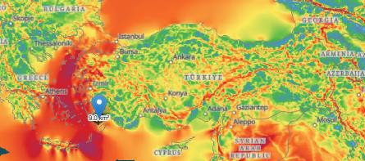
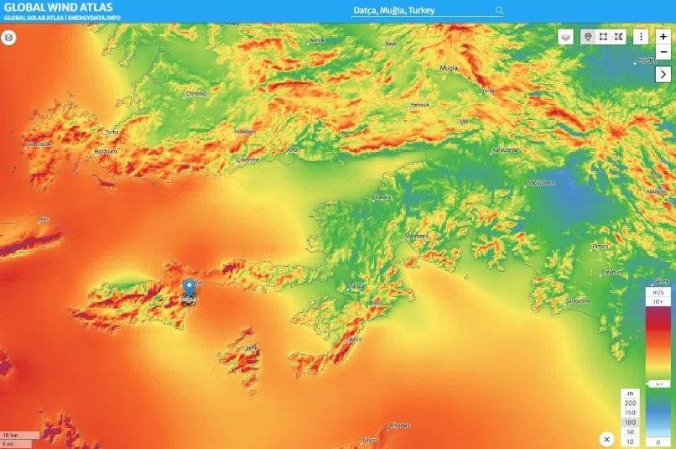
INTRODUCTION
DATA and STUDY AREA
Geographically, Datça is included in the Aegean Region and is located between 27.40-28.00 degrees east meridians and 36.60-36.75 degrees north parallels. Its surface area is 459 km². Located in the southwest of Muğla Province, there is the Gulf of Gökova, the wide Hisarönü Gulf, the Marmaris continent, the Aegean and the Mediterranean. Datça is in the Aegean Region as a ministry. It has a mountainous and rugged terrain. The highest points of the Datça Peninsula are Bozdağ (1174m amsl), Kalecik Mountain (881m), Karadağ (786m), Emecik Mountain (704m), Yarım Mountain (615m).
Hourly wind speed data observed 2021 and 2022 are taken into accounted for computer based simulations of wind speed.
Fig. Study Area Data (Muğla), https://globalwindatlas.info/en/

Slide 5
METHODOLOGY

Slide 6
Random Forest
The Random Forest algorithm is a method consisting of decision trees. As the name suggests anyway, it creates a forest and does it somehow randomly. The "forest" algorithm builds is a collection of decision trees that are mostly trained by the "bagging" method. In this method, new trees are formed by continually drawing representatives from the sample data set to substitute them, and a community arises from these trees. Based on this, they are referred as ensemble methods. All of the resulting trees are used for modelling, and each one is asked for their opinion.
The steps of this algorithm are as follows:
Step 1: In the first step, the number of decision trees (n) to be created according to the data properties is determined.
Step 2: At each node in the created decision trees, m random variables are selected, and the best branch is determined by calculating with the Gini index.
Step 3: The best branch determined in the previous step is divided into two sub-branches. This process is continued until the Gini index becomes zero, in other words, until there is only one class left in each node.
Step 4: In the last stage, if it is a classification problem, the class with the highest number of votes is chosen as the final decision, if it is a regression problem, the average of individual trees' output is returned as estimation among the predictions made by n decision trees.

Slide 7

Autoregressive Moving Average (ARMA)
ARMA models are applied to non-stationary series but converted to stationary by difference-taking. Models used to non-stationary series but converted to stationary by difference-taking are called nonstationary linear stochastic models. These models are AR, applied to series with a d-degree difference. The general representation of the models is ARMA (p, d, q). Here, p and q are the degrees of the autoregressive (AR) model and the moving average (MA) model, respectively, and d is the degree of difference. ARIMA is denoted as:

Slide 8
Vector Machines (SVM)
Support Vector Machines (SVM) is a supervised learning method. It is used for classification and regression. Points outdoor the tube are support vectors due to the fact they are helping the shape or formation of the tube. These characteristic vectors had been named support vectors. Compared to other traditional learning methods, this method has much better performance and ability to solve nonlinear problems.
In classification problems, the aim are to and the appropriate classifier function that separates the two classes. The goal is to and the best linear classifier plane even for nonexistent data. In the case of SVMs, the maximum distance between two classes is called the margin. There are infinitely many lines to separate these two classes. But there is only one line that maximizes the margin. This line is called the best separating hyperplane. In SVM, the goal is to transform the classification

Slide 9

Vector Machines (SVM)

Slide 10
LSTM Architecture
Long Short-Term Memory (LSTM) is a recurrent neural network architecture designed by Sepp Hochreiter and Jürgen Schmidhuber in 1997.

Slide 11
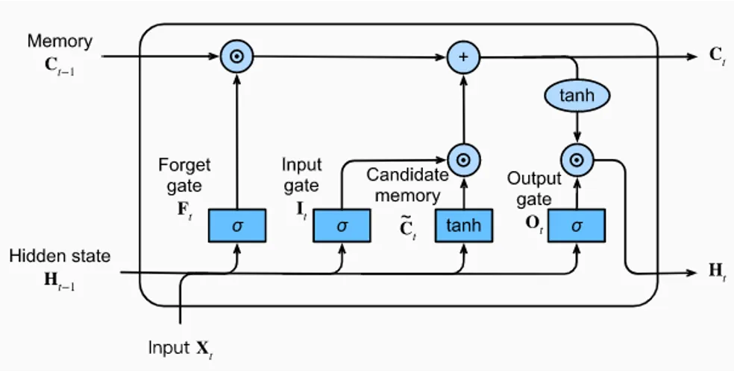
LSTM
The result of the whole process is given as a single output by taking a vote/average opinion by evaluating the opinion of each. With Random Forest, regression and classification analyses can be performed. In order to branch the nodes according to the method, the best random value in the nodes is selected, and certain weights are given to the created decision trees Figure: Architecture of a LSTM Unit (https://d2l.ai/chapter_recurrent-modern/lstm.html)

Slide 12
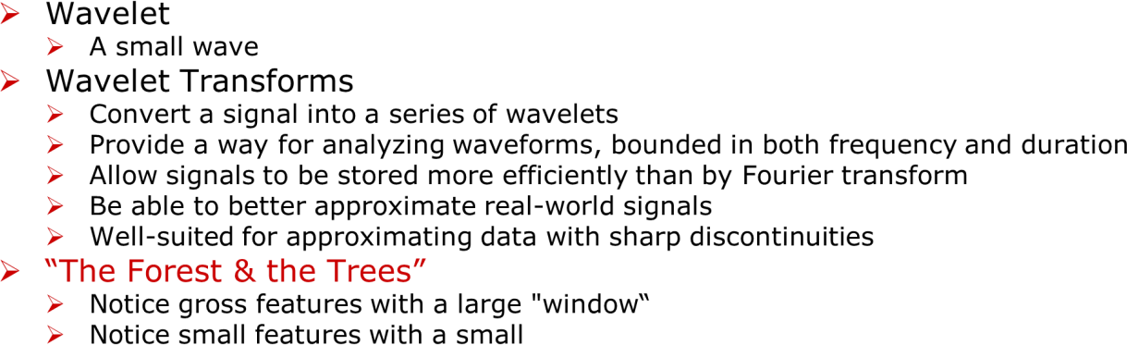
Wavelet Transforms

Slide 13
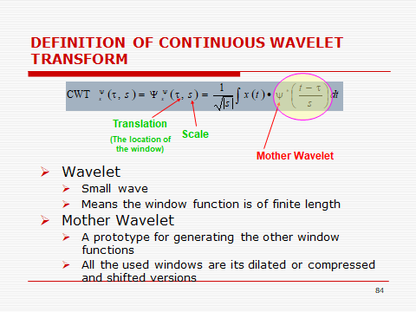

Slide 14
Findings and Discussion

Slide 15
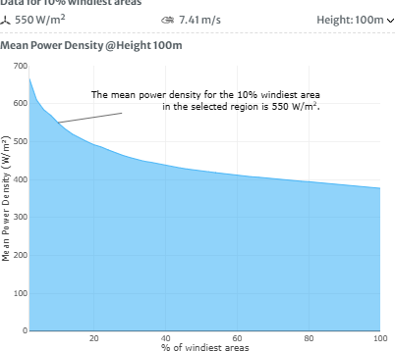
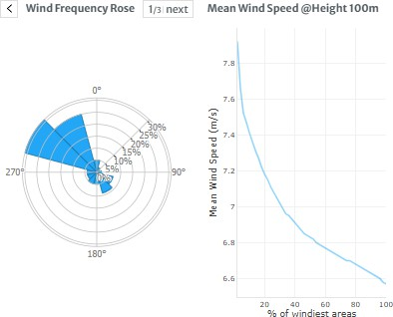
Statistical Analyses

Slide 16

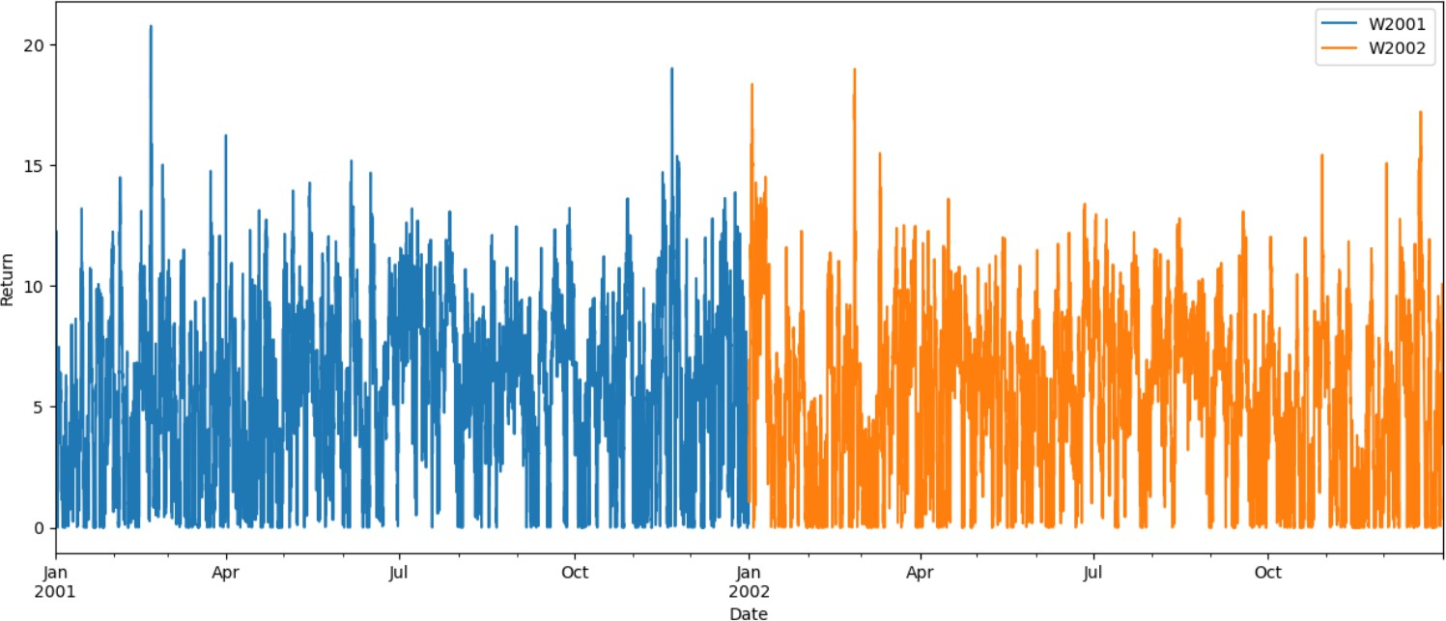
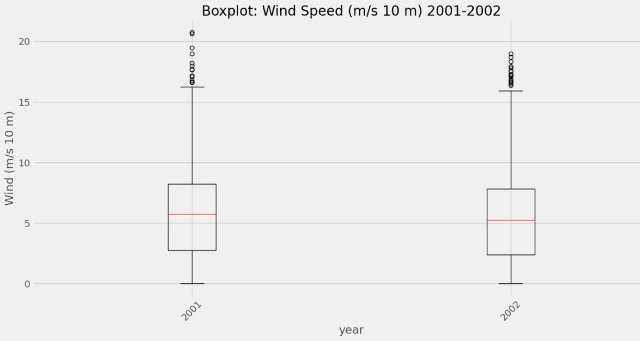
Mean wind power density and wind frequency and mean wind speed at 100m amsl
at Data,
Fig. Hourly wind speed variation in Datça (Muğla) from 2001 to 2002.
In 2001, slightly higher wind speed values were recorded than 2002 at the study area. Times series are very similar with each other.
The figure shows annual wind speed values and their Box Plots. 2001 has higher Wind Speed as Mean and outliers as well than 2002. Both plots show almost bel shape distribution of wind speed at study area.
Fig. Annual comparison of box plots at study area.

Slide 17
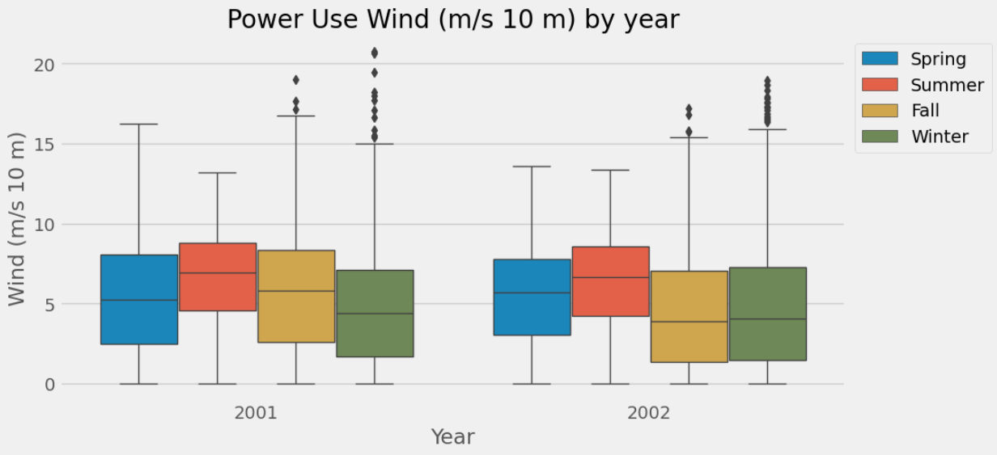
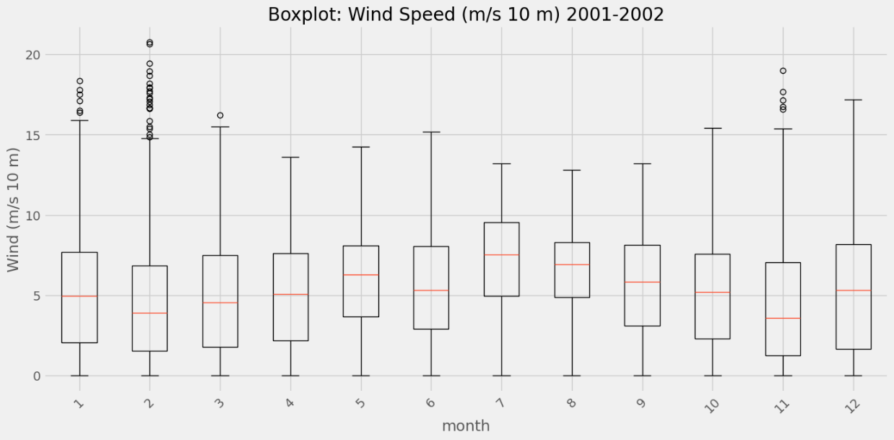
Fig. Seasonal Boxplots shows four season variation: (blue; spring, red; summer, yellow; autumn and green winter. In summer slightly, negative skewness was observed at the both study period. In 2002, fall skewness values are opposite than other seasons, there is a positive skewness.
Wind speed has the highest outliers in fall and winter, however, in summer it has the highest Mean Wind Speed Values of the year.
Monthly Boxplots:
February has the highest outliers of the year however as we see that July and August has the highest mean values for the Wind Speed.
Fig. In February, November and January we have recorded highest outliers of the year, however, wind speed values have highest mean values in July and August.

Slide 18
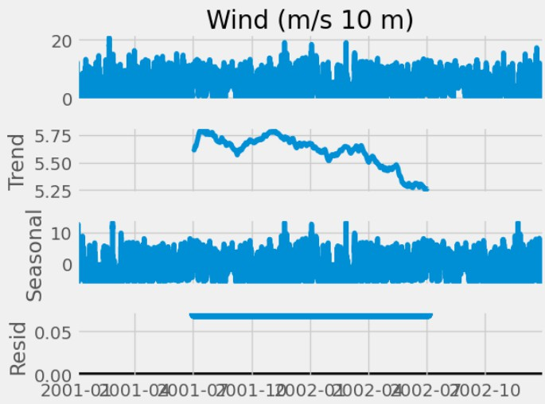
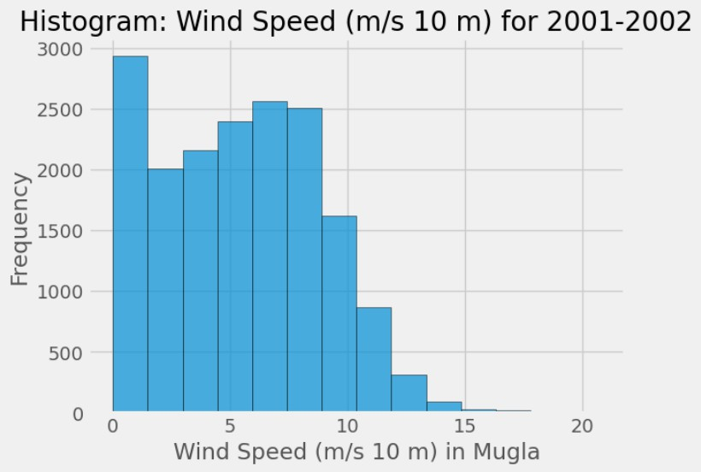
Time Series Analysis:
Fig. A decreasing trend for wind speed from 2001 to 2002.
Fig. Time series of two years data ( decomposition), hourly wind speed, in Datça.
Fig. Frequency histogram of Wind Speed in two years. There is a bi-modal distribution.

Slide 19
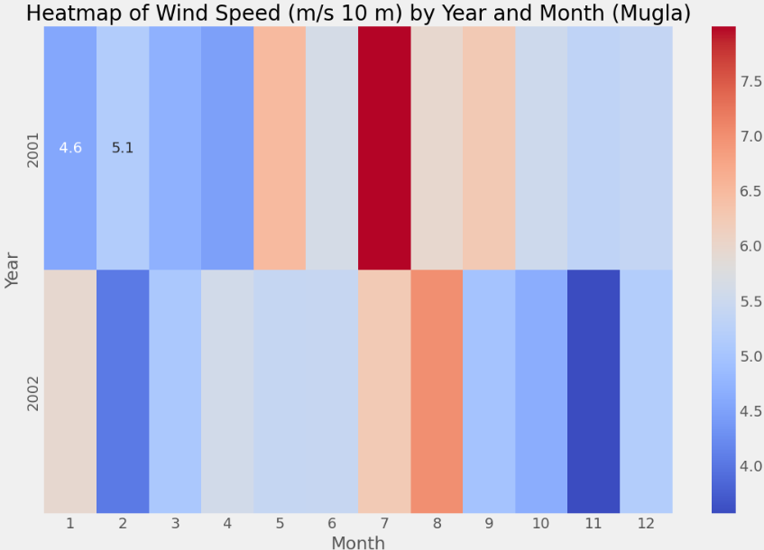
Heatmap: It is clear that July 2001 has a very high (unusual) Wind Speed, and for November 2002 it is very low Wind Speed than the usual.
Fig. Heat Map of monthly wind speed in two year.

Slide 20
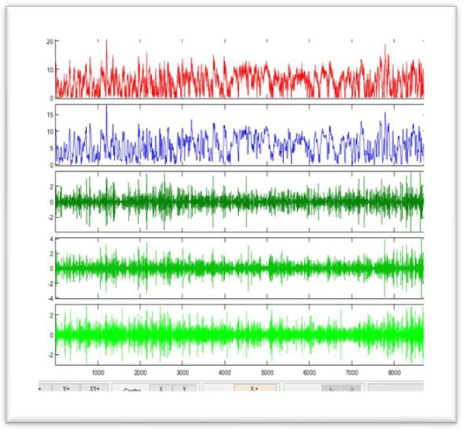
Wavelet Analyses
1D Wavelet packets and Continuous wavelet (Wavemenu, MATLAB) was applied on hourly wind speed at study area to define role of local, meso and large scale factors on it.

Slide 21
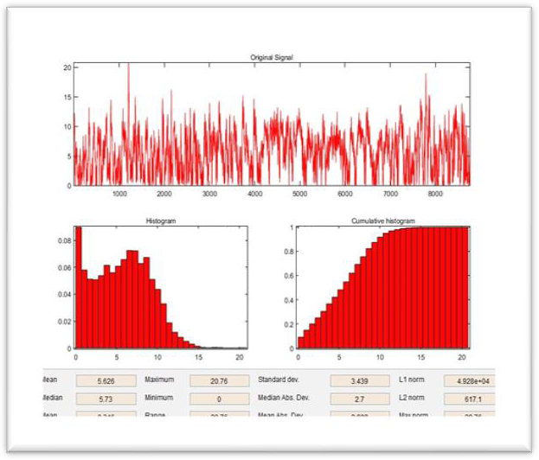
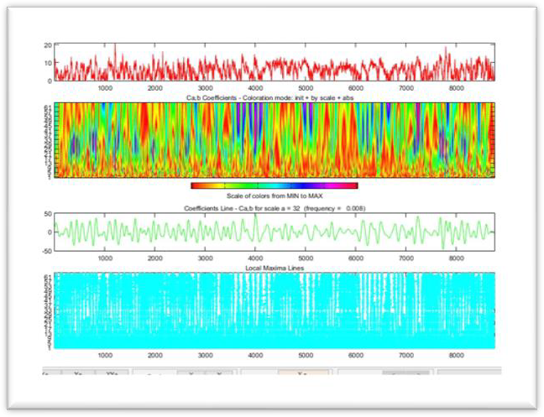
Fig… Wavelet analysis of wind speed in Datça (Muğla), in 2001, (a) 1D wavelet, (b) Statistics and (c) 1D continuous wavelet (db function).
Fig shows row data (red), approximation (blue) and wavelet details (d3, d2, d1) at study area, in 2001
Fig.(a), shows wavelet analyses of wind speed variation in Datça in 2001. High wind speed values have been recorded in winter and late autumn, In summer, role of small and large scale factors decreases. Fig. (b) shows frequency histogram, it has a bi-modal distribution. Fig.(c), explains; in winter and early spring, frequency of large scale events were lower than other seasons. The study area is under combined effect of smal, meso and large scale events. In summer and autumn frequency of large scale events are larger than other seasons. Frequency shows a gradualy decreasing trend through winter.

Slide 22
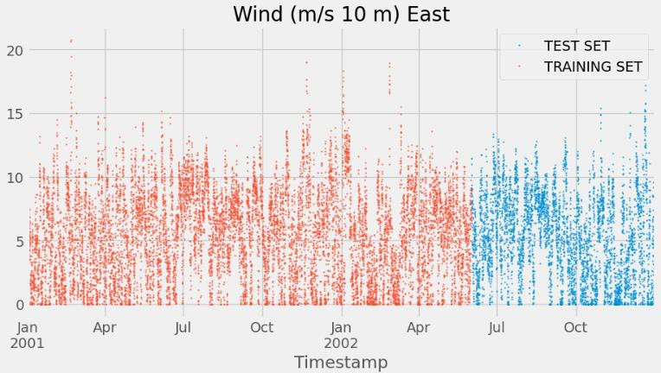
Results of wind speed analyses show a very similar variation to 2001 in 2002 at Datça, (Figs. a-b). Role of large scale events are less than 2001. Descriptive statistics are also lower in 2002. Extremes have been recorded in winter and late summer at the study area.
2002
 | min | max | mean
d1 | -3,63 | 3,63 | 0
d2 | -4,6125 | 4,6125 | -0,00013
d3 | -4,66 | 4,66 | -0,00024
In general, energy of maximum wind speed is transferred from small scale fluctuations to meso and large-scale fluctuations in 2002. For average wind speed and its energy show inverse process.
MODEL Results, Simulation
Train-Test Split: 80% of data for training and 20% of data was considered for testing.
Fig. Train-test split, hourly wind speed in Datça, (2001-2002)

Slide 23
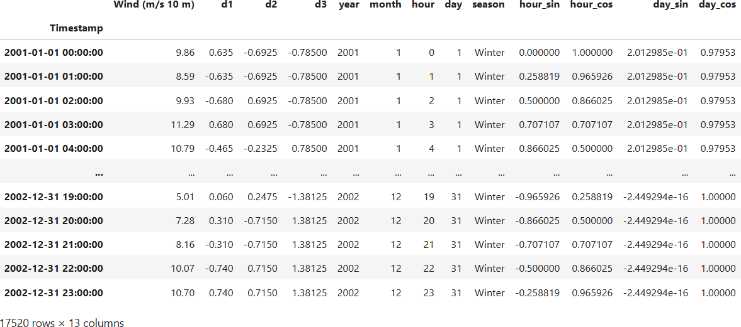
Table. Input data for hybrid modelling
Optional:
# Additional features to data preparation for increasing model performance, (under feature engineering). (Insure the model recognise continuity between the end and start of seasonal cycles).
df['hour_sin'] = np.sin(2 * np.pi * df.index.hour / 24) df['hour_cos'] = np.cos(2 * np.pi * df.index.hour / 24) df['day_sin'] = np.sin(2 * np.pi * df.index.day / 31) df['day_cos'] = np.cos(2 * np.pi * df.index.day / 31)

Slide 24
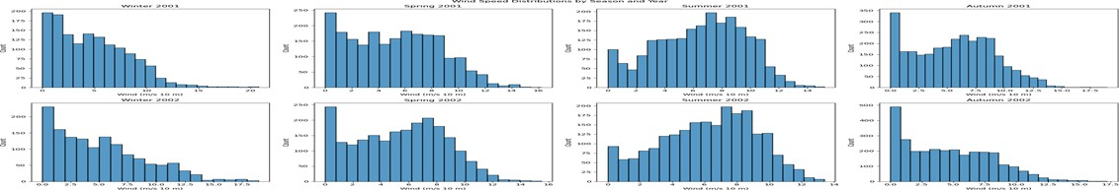
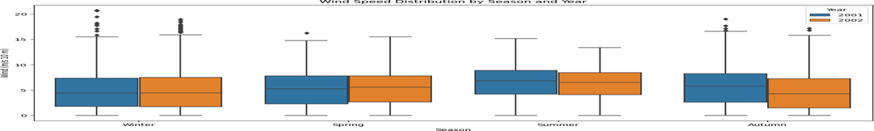
LSTM Modelling for Wind Speed in Mugla in 2001-2002
Fig. Frequency histogram and box plot of hourly wind speed for each season, in Datça, in 2001 and 2002.
MODELLING
We used the four machine learning models and we defined errors in the classical machine learning models.
LSTM (Long Short-Term Memory)
Seasonal LSTM Models for Wind Speed Forecasting
Four Independent Models for Spring, Summer, Autumn, and Winter
We implemented separate LSTM models for each season to forecast wind speeds.
Dataset: Hourly wind speeds from 2001-2002
Goal: Forecast the first 16 hours (short term) of each season in 2003

Slide 25
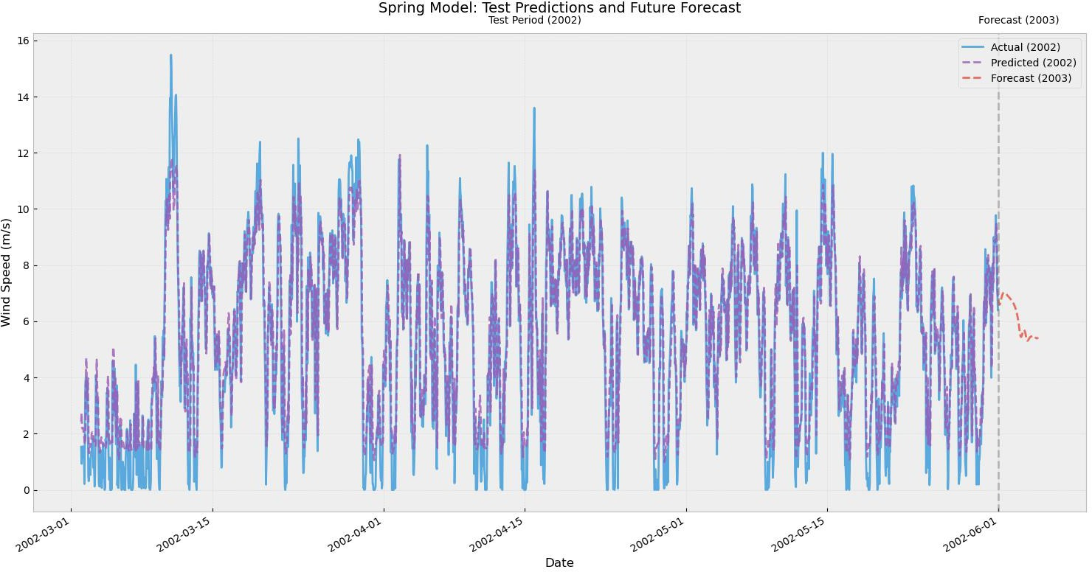
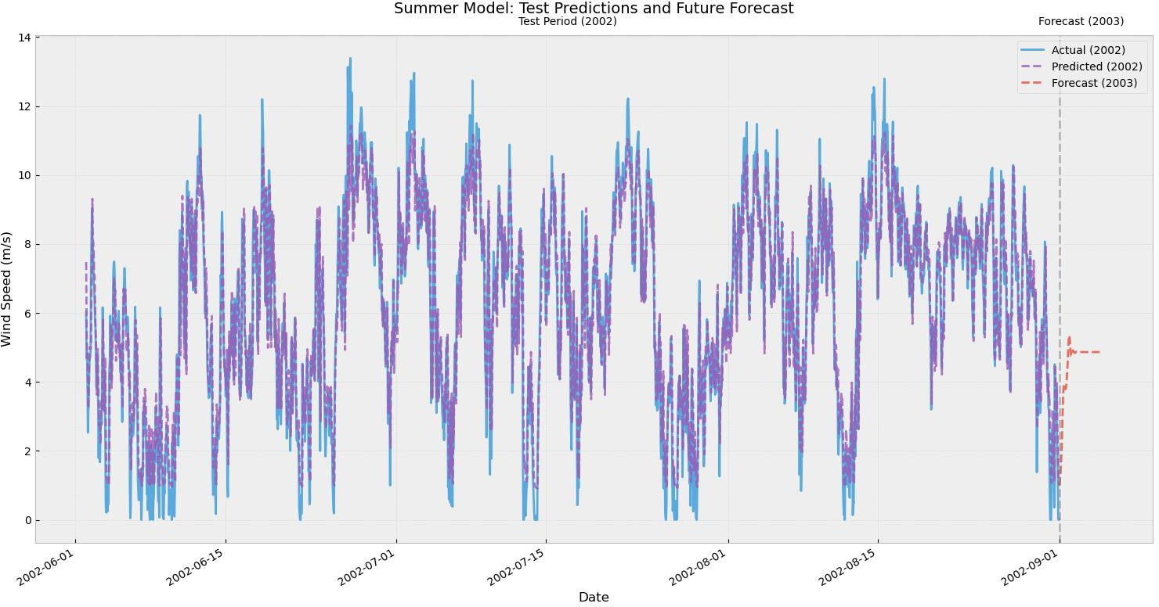
Mean Wind Speed Values:
2002 Actual: 5.38 m/s
2002 Predicted: 5.56 m/s
2003 Forecast: 6.11 m/s
==================================================
Fig. LSTM-Wavelet in Spring, (2001 and 2002)
Mean Wind Speed Values:
2002 Actual: 6.20 m/s
2002 Predicted: 6.25 m/s
2003 Forecast: 4.53 m/
Fig. LSTM-Wavelet in Summer, (2001 and 2002)

Slide 26
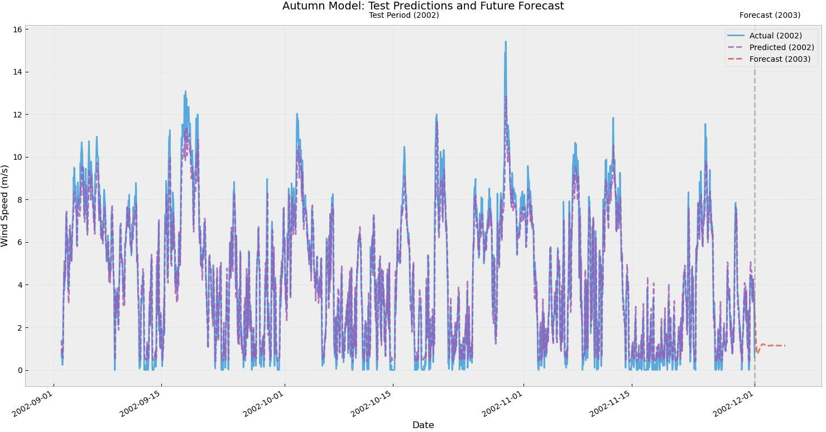
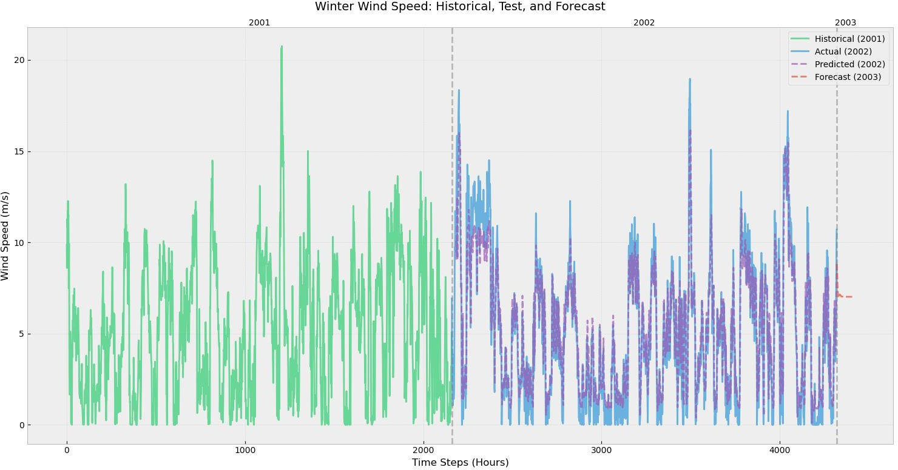
Mean Wind Speed Values: 2002 Actual: 4.42 m/s
2002 Predicted: 4.31 m/s
2003 Forecast: 1.16 m/s
Fig. LSTM-Wavelet in Autumn, (2001 and 2002)
Wind Speed Statistics: 2001 Mean: 5.03 m/s
2002 Mean: 5.09 m/s
2003 Forecast Mean: 7.10 m/s
Fig. LSTM-Wavelet in Winter, (2001 and 2002)

Slide 27
LSTM- WAVELET | MAE | RMSE | LSTM | MAE | RMSE
Spring | 0.93 | 1.21 | Spring | 0.88 | 1.16
Summer | 0.80 | 1.04 | Summer | 0.81 | 1.06
Autumn | 0.79 | 1.08 | Autumn | 0.83 | 1.12
Winter | 1.05 | 1.38 | Winter | 1.32 | 1.72
In spring, LSTM shows slightly better performance than LSTM-WAVELET after MAE (m/s) and RMSE (m/s). For all other seasons, hybrid model performs better than single LSTM for simulation of short term (16 hr. wind speed).
CONCLUSION
As a conclusion, the Hybrid model (LSTM-Wavelet) shows slightly higher reliability for prediction and estimation of short-term hourly wind speed data at the study area.
LIMITATION AND RECOMMENDATION
The future work will be deal with comparison of different models with longer wind speed data. Longer data will increase precission and accuracy of models.

Slide 28


Türkiye’s target of investing 3,500 megawatts of solar energy and 1,500 megawatts of wind energy every year until 2035.
Offshore wind energy system for 2025, 5GW system has been planned.
SDGs, No: 7 Clean Enery

Slide 29
SUMMARY
The utilization of renewable energy resources is mainly related to the problem of the prediction precision of wind speed. Based on wind speed data, the definition of wind energy potential emphasizes ensuring the efficiency and reliability of wind energy systems. The objective of this work is to present a comprehensive review of artificial intelligence (AI) techniques applied to forecast short-term wind speed.
The study compares systematically six different AI models, ranging from machine learning models like high-capacity models that comprise Random Forests, Support Vector Machine, autoregressive moving average (ARMA), Linear and Logistic Regression to more complex models like Long Short-Term Memory (LSTM) networks.
The models are trained and validated against extensive historical records of wind speeds. This paper covers some analysis related to the hourly data collected at the west of the Mediterranean Sea (Mugla City at the Latitude: 556335 and Longitude: 4070184 [ED-50 formats]), between 2001 and 2002.
The study highlights the greater significance of new predictive analytics as a move towards ending the issues of incorporating renewable energy sources into traditional power systems. The study also provides useful insight into AI-based forecasting system design and implementation, paving the way for breakthroughs in environmental applications.
Keywords: Wind energy, sustainability, data driven predictions, machine learning, artificial intelligence
APPENDIX
Pseudo codes: https://github.com/apodwikat/

Slide 30
Acknowledgments:
This study is supported by NATO SPS Multi-Year Project number G5970 named Cube4EnvSec: “Big Earth Data Cube Analytics for Transnational Security and Environment Protection”. The authors also thank to Turkish State Meteorological Service for the data used in the study. The author(s) would like to thank Prof. Dr. Peter BAUMANN, Construction University and Dr. Rene HEISE, NATO HQ: Innovation Hybrid Cyber Division for their support in this paper.

Slide 31
REFERENCES
M AlShafeey, C Csaki, “ Adaptive Machine Learning For Forecasting İn Wind Energy: A Dynamic, Multi-Algorithmic Approach For Short And Long-Term Predictions”, Heliyon, Volume 10, Issue 15 e34807 August 15, 2024
J Kim, HJ Shin, K Lee, J Hong, “ Enhancement Of ANN-Based Wind Power Forecasting By Modification Of Surface Roughness Parameterization Over Complex Terrain”, Journal Of Environmental Management, Volume 362, June 2024,- Elsevier
Y Wang, “Deep Learning Techniques in Renewable Energy Forecasting: Solving Intermittency and Instability in Solar and Wind Energy”, 4th International Conference on Energy, 2024 - ieeexplore.ieee.org
E. Tan, Ş. S. Menteş, E. Unal, Y. Unal, B. Efe, B. Barutcu, B. Onol, H. S. Topcu, S., İncecik, “Short Term Wind Energy Resource Prediction Using WRF Model For A Location İn Western Part Of ,Turkey”, J. Of. Renewable and Sustainable Energy 13, 013303, 09 February, 2021,
U.G.B., Gorgun and Ş.S. Menteş, “Analyzing Wintertime ExtremeWinds over Turkiye and Their Relationships with Synoptic Patterns Using Cluster Analysis” , Atmosphere, Atmosphere 2024, 15(2), 196; PP. 1-26,

Slide 32
REFERENCES
E. Kaya, B.Barutçu, Ş. S. Menteş, “Improving Performance in Deterministic Prediction Methods of Wind Energy with Using Heuristic Methods”, International Energy Raw Materials and Energy Summit (INERMA), Istanbul- Turkiye, 1-3 October, 2015,
Abinet T., Zhang, J. H., Zheng D. H., and Dereje, S., “Short-term wind power forecasting using artificial neural networks for resource scheduling in microgrids,” International Journal of Science and Engineering Applications 5(3), 144–151 (2016).https://doi.org/10.7753/IJSEA0503.1005
Grassi, G. and Vecchio, P., “Energy prediction using a two-hidden layer neural network,” Commun. Nonlinear Sci. Numer. Simul. 15(9), 2262–2266 (2010).
Saleh, A. E., Moustafa, M. S., Abo-Al-Ez, K. M., and Abdullah, A. A., “A hybrid neuro-fuzzy power prediction system for wind energy generation,” Int. J. Electr. Power Energy Syst. 74, 384–395 (2016).https://doi.org/10.1016/j.ijepes.2015.07.039.
https://iicec.sabanciuniv.edu/sites/iicec.sabanciuniv.edu/files/inline-files/IICEC_TEEO_25.pdf • Türkiye Enerji Verimliliği Görünümü Yönetici Özeti (Türkçe ve İngilizce) için: https://iicec.sabanciuniv.edu/sites/iicec.sabanciuniv.edu/files/inline-files/IICEC_TEEO_25_ES.pdf • Türkiye Enerji Verimliliği Görünümü lasnman sunumu için: https://iicec.sabanciuniv.edu/sites/iicec.sabanciuniv.edu/files/inlinefiles/IICEC%20_TEVG_2025_Lansman%20Sunumu.pdf
TÜREB: https://www.tureb.com.tr/

Slide 33
LinkedIn: https://www.linkedin.com/in/abdallah-dwikat-04095927b/
Email: abdallahdwikat@stu.aydin.edu.tr, zaferaslan@aydin.edu.tr
Sibel.mentes@.gmail.com
tokgozlu68@gmail.com
Thank you

